Slide 1

MutiSales Distribution System
BUAI 492
Foundations of Python Programming
Group 4
Date：Oct.28th.2022

Slide 2
01
Main Menu
Welcome to MutiSales Distribution System
Check Inventory and Trucks
Truck Arrangement
Set current order plan
Ship items
Clear form
Exit

Slide 3
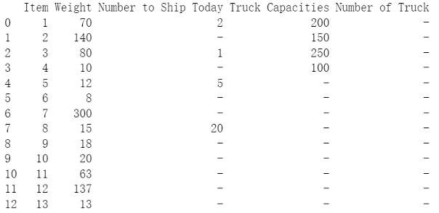
02
Check Inventory and Trucks
The purpose of this step is to verify daily inventory and available truck information.
Back

Slide 4
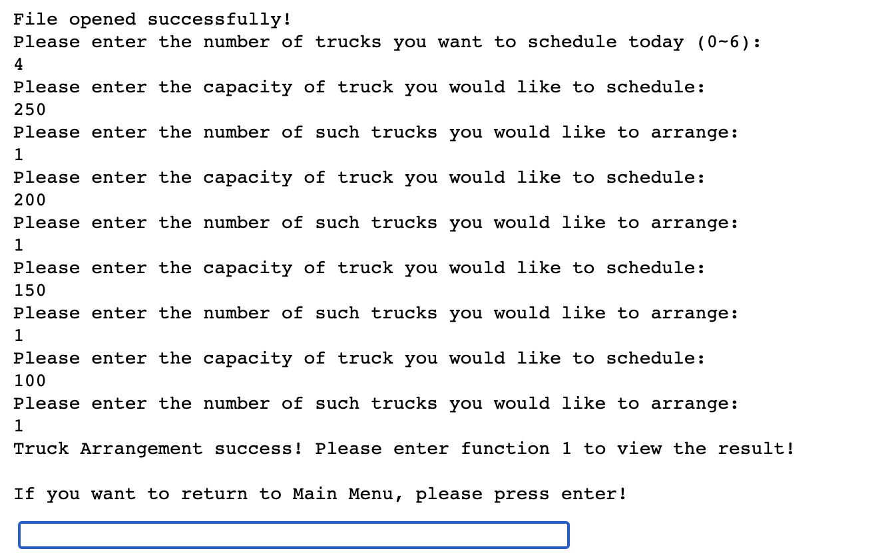
03
Truck Arrangement
In this step the manager can enter the truck information that will be used in the daily work.
First, set the number of trucks that will be used, then enter the different capacities and quantities.
Back

Slide 5
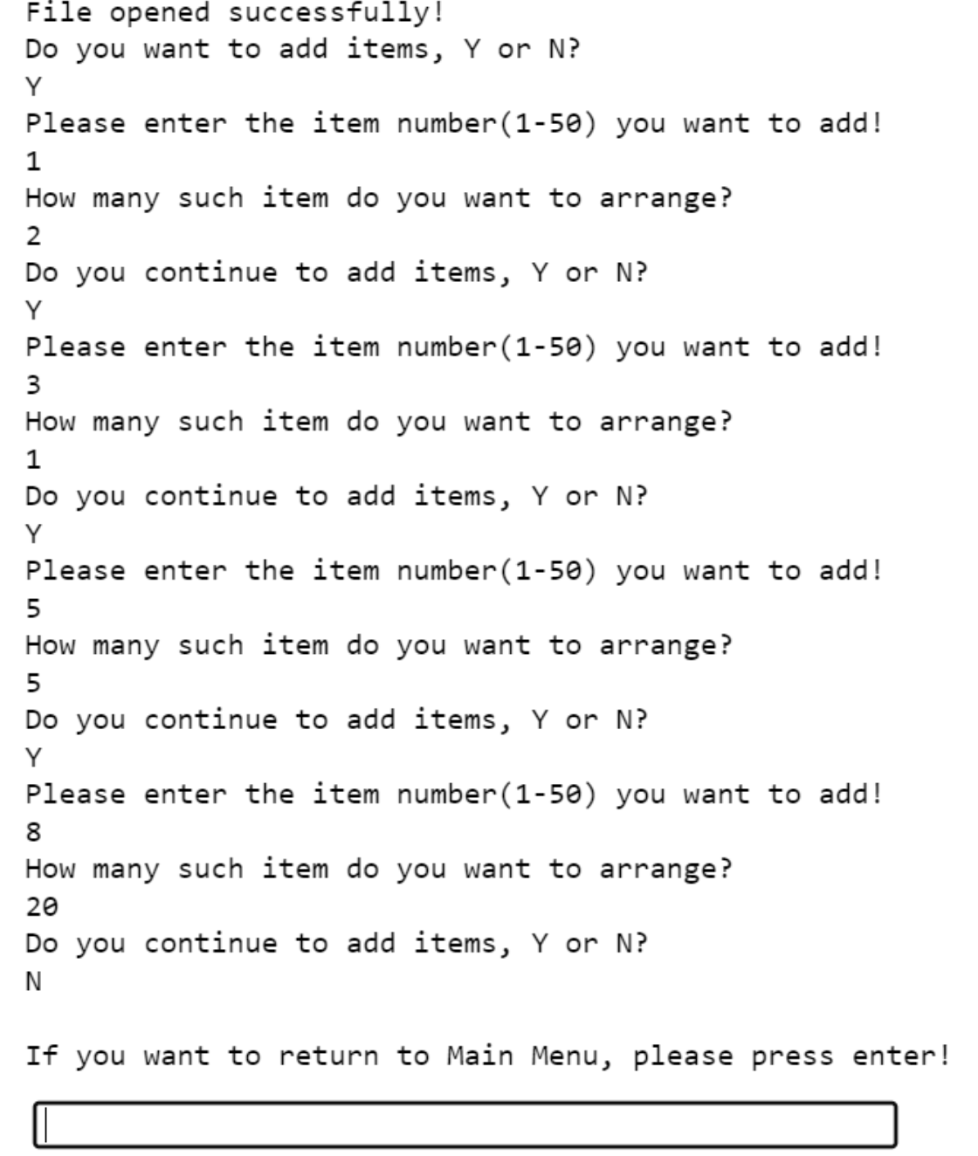
Set current order plan
04
Here the manager also need to enter the data for daily items which need to be shipped.
Back

Slide 6
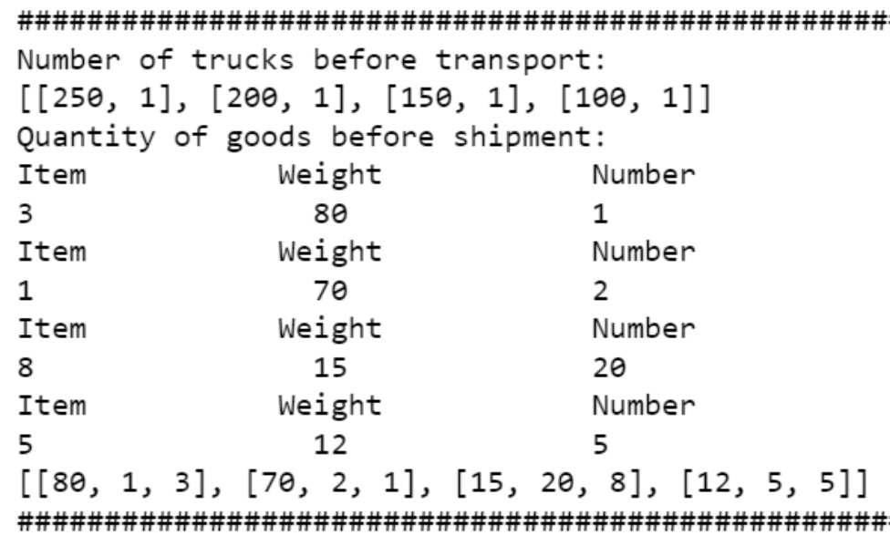
05
Ship Items-1
As the main part of the program, this step will effectively assign the task of loading items.
List the truck’s capacities, truck’s quantity; item number, item quantity, and item weight.
Back

Slide 7
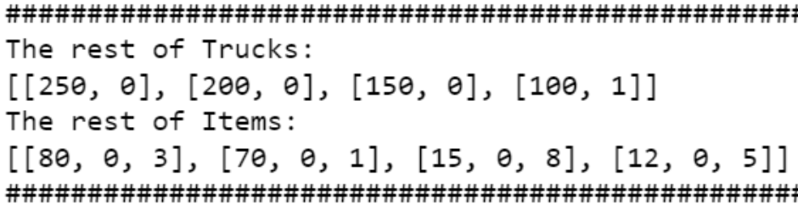
06
Ship Items-2
The program also displays unused trucks, item numbers and item quantities that failed to load.
Back

Slide 8
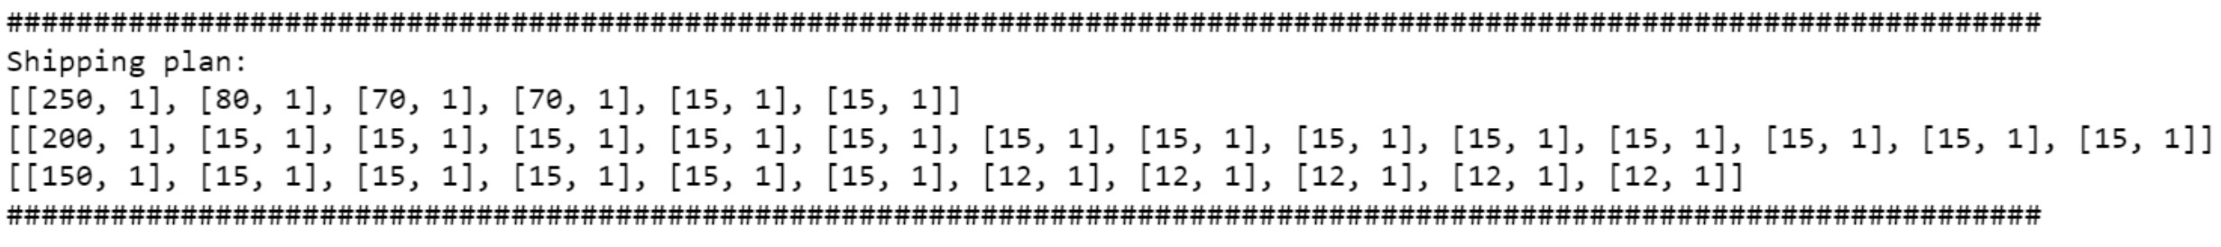
07
Ship Items-3
The final shipping plan will be displayed in the program, sorted by truck usage and information on the items loaded on each truck.
Back

Slide 9
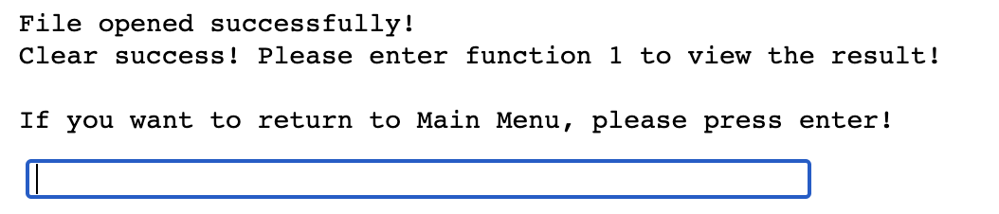
08
Clear form
In order to be more efficient, users need to clear the data in the form to save time and make sure program started successfully for the next use.
Back

Slide 10
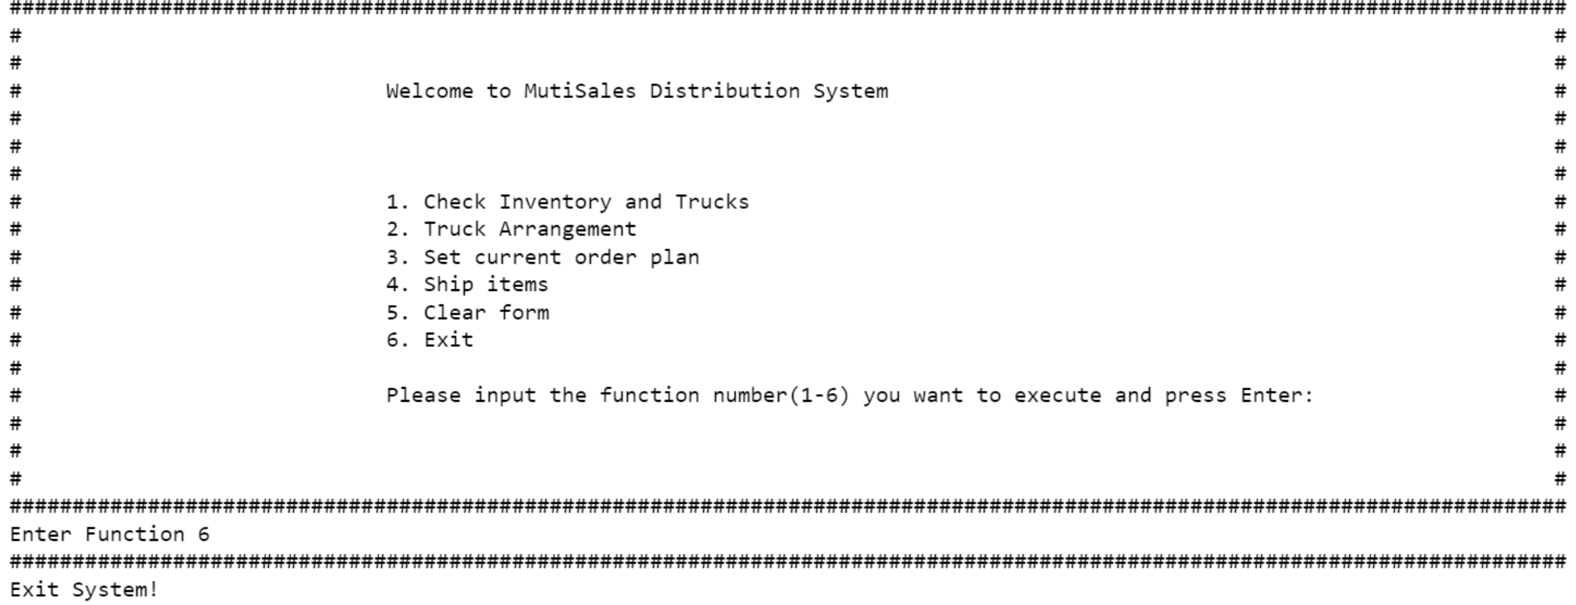
09
Exit
Enter 6 in the menu to exit the program.
Back

Slide 11
Group members and e-mail addresses
Yuqing Gu yxg718@case.edu
Ziming Cui zxc701@case.edu
Zeyao Yang zxy690@case.edu

Slide 12
Thanks for Watching!

